Slide 1

Balancing & Control of Segway Robot Using Classical and Modern Control Techniques
(In Submission for Midsemester Research Project Evaluation)
Presented by :
Pritam Ranjan Kalita
MTech Robotics Engineering (3rd Semester)
School of Advanced Engineering
Project Supervisor:
Dr. Rahul Singhal
Electrical Cluster
School of Advanced Engineering

Slide 2
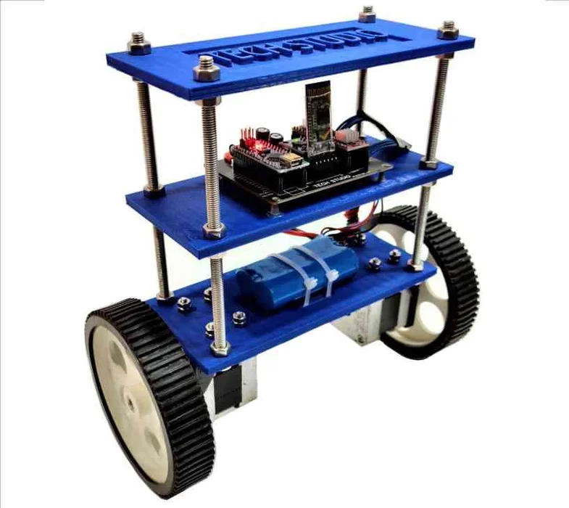
Motivation
The Self Balancing Segway Robot is inspired from the Cart & Inverted Pendulum (CIP) model which is a classical problem studied in Control Engineering. The operational principles of CIP model also used in designing of self-balancing hoverboards, Humanoid and Bipedal Robots, Rocket and Missile Guidance systems etc.
Segway-type robots serve as a platform for testing innovative control strategies that can be then extended to more complex robotic systems and autonomous vehicles.
Figure 1. A self-balancing Segway robot. Adapted from "Self-Balancing Robot Using Arduino" by My Tech Studio, Instructables. Retrieved from https://www.instructables.com/Self-Balancing-Robot-Using-Arduino/. Copyright by Instructables.

Slide 3
Literature Review
[1] Mudeng et al. mathematically modeled and simulated a two-wheeled balancing robot, employing a PID controller and Ziegler–Nichol’s method for tuning the PID gains in Simulink.
[2] Putra et al. developed and implemented an LQR-based control system for a two-wheeled self-balancing robot, validating their mathematical model through both simulation and physical experiments.
[3] Mohammed and Abdulla designed an LQR controller to stabilize a Segway robot, and used genetic algorithm and bacteria foraging optimization to tune controller’s Q and R parameters.
[4] Feriyonika and Hidayat in their study implemented Linear Quadratic Gaussian (LQG) control for a two-wheeled self-balancing robot, combining a Kalman filter with Linear Quadratic Regulator (LQR) to reduce sensor noise and optimize balance performance.
[5] Burkan and Ozguney in their study developed and applied adaptive-robust and fuzzy logic controllers for balancing a two-wheeled Segway robot.

Slide 4
Research Objectives
Study the mathematical model of the Segway Self-Balancing Robot and derive the Transfer function and State-Space model equations for application in design of linear controllers – PID and LQR.
Implement a PID controller for controlling the system. Simulate the results using MATLAB & SIMULINK.
Implement a LQR controller for controlling the system and use Genetic Algorithm for tunning of the Q and R parameters. Simulate the results using MATLAB & SIMULINK.
Implement an advanced Non-Linear Controller for controlling the system. Simulate the results using MATLAB & SIMULINK.

Slide 5
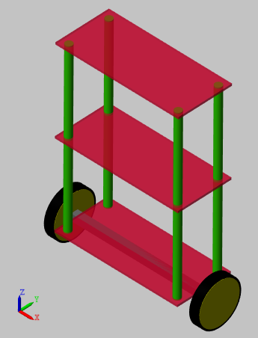
Methodology
Model Specifications :
Mass of each plate (kg) | 1
Dimensions of each plate (cm) | 18 x 8 x 0.3
Mass of each corner support rod (kg) | 0.0625
Radius of each corner support rod (mm) | 5
Height of each corner support rod (cm) | 25
Dimensions of connecting rod between the wheels (cm) | 20 x 1 x 1
Mass of connecting rod between the wheels (kg) | 0.1
Radius of each wheel (m) | 0.0325
Mass of each wheel (kg) | 0.05
Table 1. Some Model Specifications of the Segway Robot as simulated in MATLAB-Simulink
Figure 2. Model of the Self-Balancing Segway Robot as simulated in MATLAB-Simulink

Slide 6
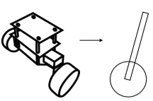

Methodology
Mathematical Model of Segway Robot:
From our model specifications (last slide), we set some constants which we will need later for finding the Transfer Function and State Space Model equations of the robot :
M_{c} = Mass of Chassis = 1 kg
M_{w} = Mass of each Wheel = 0.1 kg
L_{c} = Distance of COM of the chassis from the axis of rotation of wheels
= 0.129 m
R_{w} = Radius of each wheel = 0.0325 m
I_{c} = Moment of Inertia of Chassis rotating abt. Wheel axis
= $\frac{1}{12} . M_{c} . {L^{2}}_{c}$
I_{w} = Moment of Inertia of Wheel rotating abt. Wheel axis
= $\frac{1}{2} . M_{w} . {R^{2}}_{w}$
COM
θ
L_{c}
Y
X
Figure 3. Simplified Model of the Self-Balancing Segway Robot used for Mathematical Analysis
Source: [4] Feriyonika, F. & Hidayat, A. (2020). Balancing Control of Two-Wheeled Robot by Using Linear Quadratic Gaussian (LQG).

Slide 7
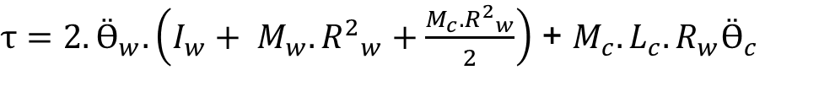
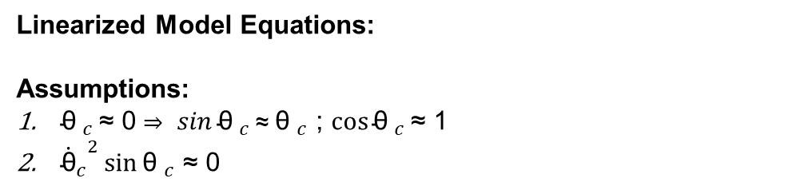
Methodology
Mathematical Model of Segway Robot:
COM
Non-Linearized Model Equations:
θ
$τ=2.Ӫ_{w}.\left(I_{w}+ M_{w}. {R^{2}}_{w}+\frac{M_{c}. {R^{2}}_{w}}{2}\right)$ + $M_{c}.L_{c}.R_{w}(Ӫ_{c}\cos{{\text{θ} }_{c}}−{{\dot{\text{θ}}}_{c}}^{2}\sin{{\text{θ} }_{c}})$
$−$ $τ=Ӫ_{c}\left(I_{c} +M_{c}.{L^{2}}_{c}\right)+ M_{c}L_{c}R_{w}Ӫ_{w}$ $\cos{{\text{θ} }_{c}} −M_{c}L_{c}g\sin{{\text{θ} }_{c}}$
Y
L_{c}
Linearized Model Equations:
Assumptions:
${\text{θ} }_{c }\text{≈} \text{0 }\text{⇒} sin{{\text{θ} }_{c}}\text{≈} {\text{θ} }_{c}$ ; $\cos{{\text{θ} }_{c}}\text{≈}\text{ 1}$
${{\dot{\text{θ}}}_{c}}^{2}\sin{{\text{θ} }_{c}}$ $\text{≈}$ 0
X
Figure 4. Simplified Model of the Self-Balancing Segway Robot used for Mathematical Analysis
Source: [4] Feriyonika, F. & Hidayat, A. (2020). Balancing Control of Two-Wheeled Robot by Using Linear Quadratic Gaussian (LQG).
$τ=2.Ӫ_{w}.\left(I_{w}+ M_{w}. {R^{2}}_{w}+\frac{M_{c}. {R^{2}}_{w}}{2}\right)$ + $M_{c}.L_{c}.R_{w}Ӫ_{c}$
$−$ $τ=Ӫ_{c}\left(I_{c} +M_{c}.{L^{2}}_{c}\right)+ M_{c}L_{c}R_{w}Ӫ_{w}$ $−M_{c}{.L}_{c}.g.{\text{θ} }_{c}$

Slide 8

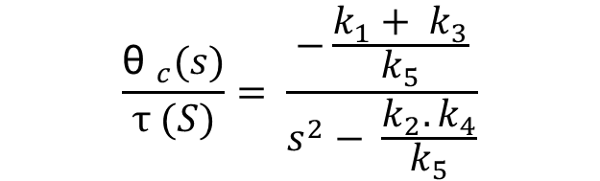
Methodology
Mathematical Model of Segway Robot:
Transfer Function of the Segway Robot Plant:
COM
$$\frac{{\text{θ} }_{c}(s)}{τ (S)}= \frac{−\frac{k_{1}+ k_{3}}{k_{5}}}{s^{2}− \frac{k_{2}. k_{4}}{k_{5}}}$$
θ_{c}
L_{c}
Y
${\text{θ} }_{c}$ = Chassis Tilt Angle Plant Output (Feedback)
$τ$ = Torque applied to each individual wheel Plant Input (Control Signal)
$k_{1}=M_{c}.{L^{2}}_{c}+ I_{c}$
$k_{2} = M_{c}.{R^{2}}_{w}+{2.M}_{w}.{R^{2}}_{w}+2.I_{w}$
$k_{3}= M_{c}.R_{w}.L_{c}$
$k_{4}=M_{c}.L_{c}.g$
$k_{5}=k_{1}.k_{2} −k_{3}^{2}$
X
Figure 3. Simplified Model of the Self-Balancing Segway Robot used for Mathematical Analysis
Source: [4] Feriyonika, F. & Hidayat, A. (2020). Balancing Control of Two-Wheeled Robot by Using Linear Quadratic Gaussian (LQG).

Slide 9


Methodology
Mathematical Model of Segway Robot:
State-Space Model of the Segway Robot Plant:
COM
$ẋ\left(t\right)=$ $Ax\left(t\right)+Bu\left(t\right)$ -- State Equation
$y\left(t\right)=Cx\left(t\right)+Du(t)$ -- Output Equation
θ_{c}
L_{c}
$$ẋ\left(t\right)=\left[\begin{matrix}\text{θ}\text{c} \\ { θ ̇}_{c} \\ {\text{θ}}_{w} \\ { θ ̇}_{w}\end{matrix}\right], A= \left[\begin{matrix}0 & 1 & 0 & 0 \\ \frac{k_{2}.k_{4}}{k_{5}} & 0 & 0 & 0 \\ 0 & 0 & 0 & 1 \\ −\frac{k_{1}.k_{4}}{k_{5}} & 0 & 0 & 0\end{matrix}\right], B= \left[\begin{matrix}0 \\ −\frac{k_{2}+k_{3}}{k_{5}} \\ 0 \\ \frac{k_{1}+k_{3}}{k_{5}}\end{matrix}\right]$$
$$y\left(t\right)=\left[\begin{matrix}\text{θ}\text{c} \\ { θ ̇}_{c} \\ {\text{θ}}_{w} \\ { θ ̇}_{w}\end{matrix}\right], u\left(t\right)=\left[τ\right], C= \left[\begin{matrix}1 & 0 & 0 & 0 \\ 0 & 1 & 0 & 0 \\ 0 & 0 & 1 & 0 \\ 0 & 0 & 0 & 1\end{matrix}\right], D=\left[0\right]$$
Y
X
Figure 3. Simplified Model of the Self-Balancing Segway Robot used for Mathematical Analysis
Source: [4] Feriyonika, F. & Hidayat, A. (2020). Balancing Control of Two-Wheeled Robot by Using Linear Quadratic Gaussian (LQG).

Slide 10
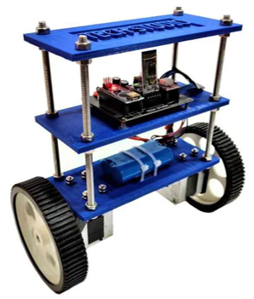


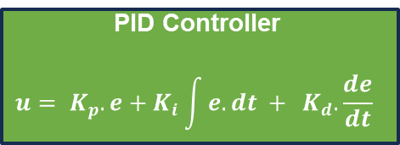
Methodology
PID Controller Implementation
PID Controller
$$u= K_{p}.e+K_{i}\int{e. dt + } K_{d}.\frac{de}{dt}$$
Control Signal
(Wheel Torque)
$$R_{ref}$$
$$e$$
+
-
Plant
(Physical Model / Transfer Function)
Feedback (Chassis Tilt Angle)

Slide 11
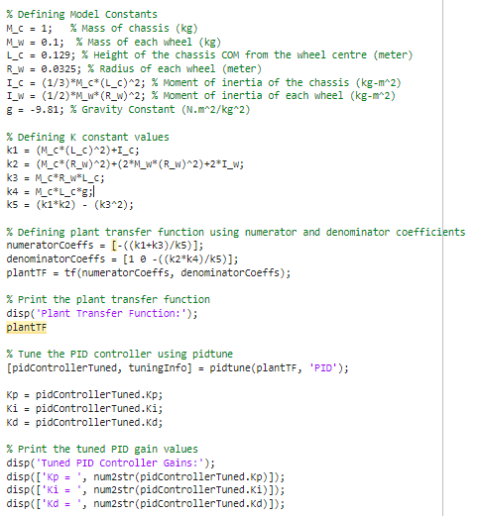
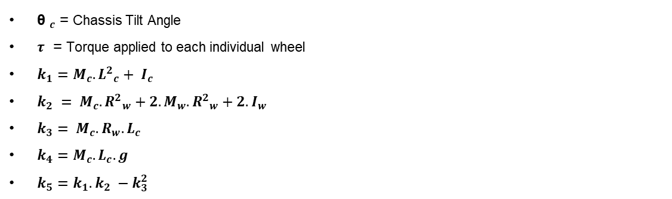


Methodology
PID Controller Implementation: Tuning of PID Gains
MATLAB Code For Getting Tuned PID Parameters:
M_{c} = Mass of Chassis = 1 kg
M_{w} = Mass of each Wheel = 0.1 kg
L_{c} = Distance of COM of the chassis from the axis of rotation of wheels
= 0.129 m
R_{w} = Radius of each wheel = 0.0325 m
I_{c} = Moment of Inertia of Chassis rotating abt. Wheel axis
= $\frac{1}{12} . M_{c} . {L^{2}}_{c}$
I_{w} = Moment of Inertia of Wheel rotating abt. Wheel axis
= $\frac{1}{2} . M_{w} . {R^{2}}_{w}$
Transfer Function of the Segway Robot Plant:
$$\frac{{\text{θ} }_{c}(s)}{τ (S)}= \frac{−\frac{k_{1}+ k_{3}}{k_{5}}}{s^{2}− \frac{k_{2}. k_{4}}{k_{5}}}$$
${\text{θ} }_{c}$ = Chassis Tilt Angle
$τ$ = Torque applied to each individual wheel
$k_{1}=M_{c}.{L^{2}}_{c}+ I_{c}$
$k_{2} = M_{c}.{R^{2}}_{w}+{2.M}_{w}.{R^{2}}_{w}+2.I_{w}$
$k_{3}= M_{c}.R_{w}.L_{c}$
$k_{4}=M_{c}.L_{c}.g$
$k_{5}=k_{1}.k_{2} −k_{3}^{2}$

Slide 12
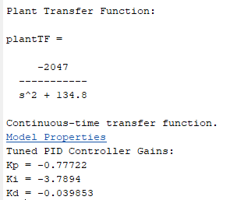
Methodology
PID Controller Implementation: Tuning of PID Gains
Code For Getting Tuned PID Parameters:

Slide 13
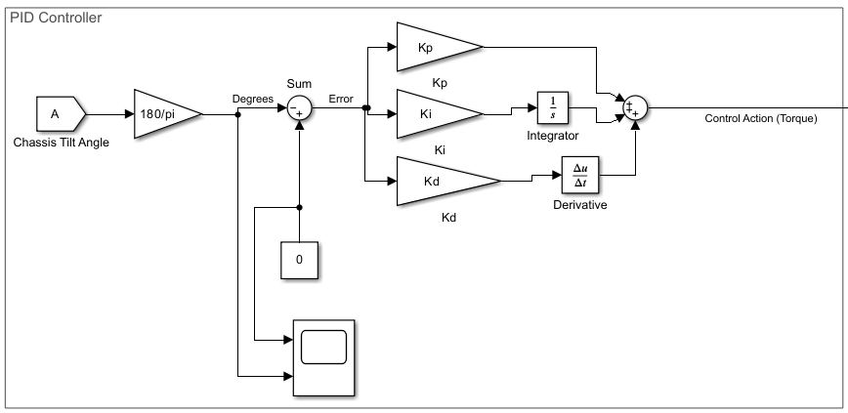
Methodology
PID Controller Implementation: Simulink Block Diagram of PID Controller
Figure 4. Block Diagram of PID Controller as implemented in Simulink

Slide 14
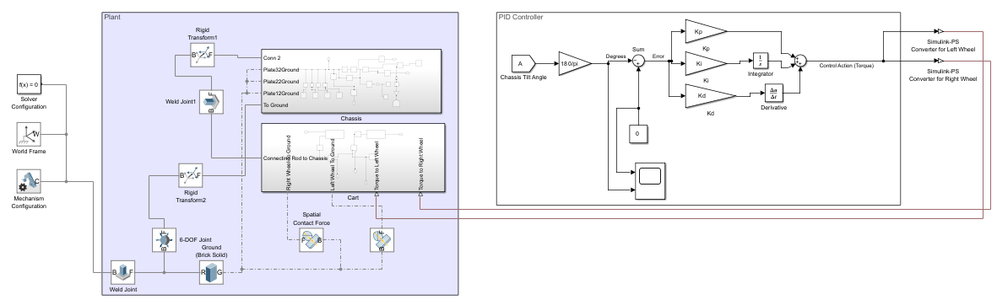
Methodology
PID Controller Implementation: Simulink Block Diagram of Complete Project

Slide 15
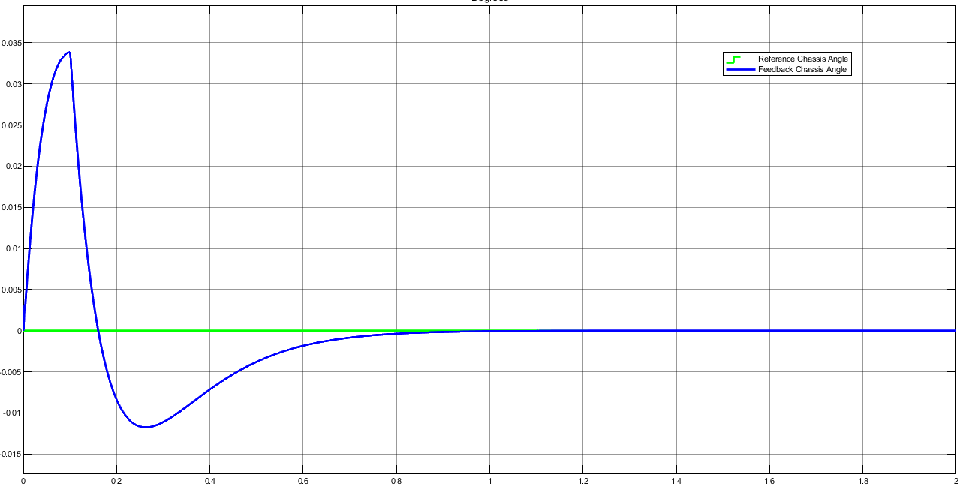
Results
Figure 5: Chassis Tilt Angle ($\text{θ}\text{c}$) v/s Time Graph from PID Controlled Segway Robot Simulation in MATLAB-SIMULINK

Slide 16
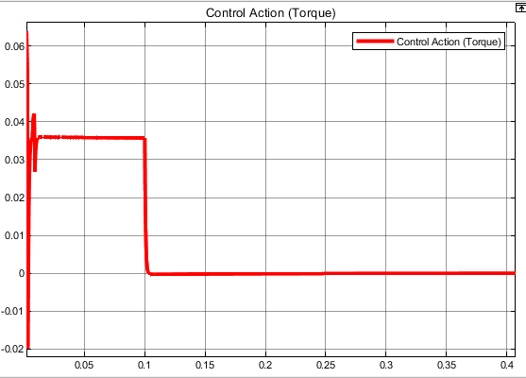
Results
Figure 5: Control Action/Torque ($τ$) v/s Time Graph from PID Controlled Segway Robot Simulation in MATLAB-SIMULINK

Slide 17
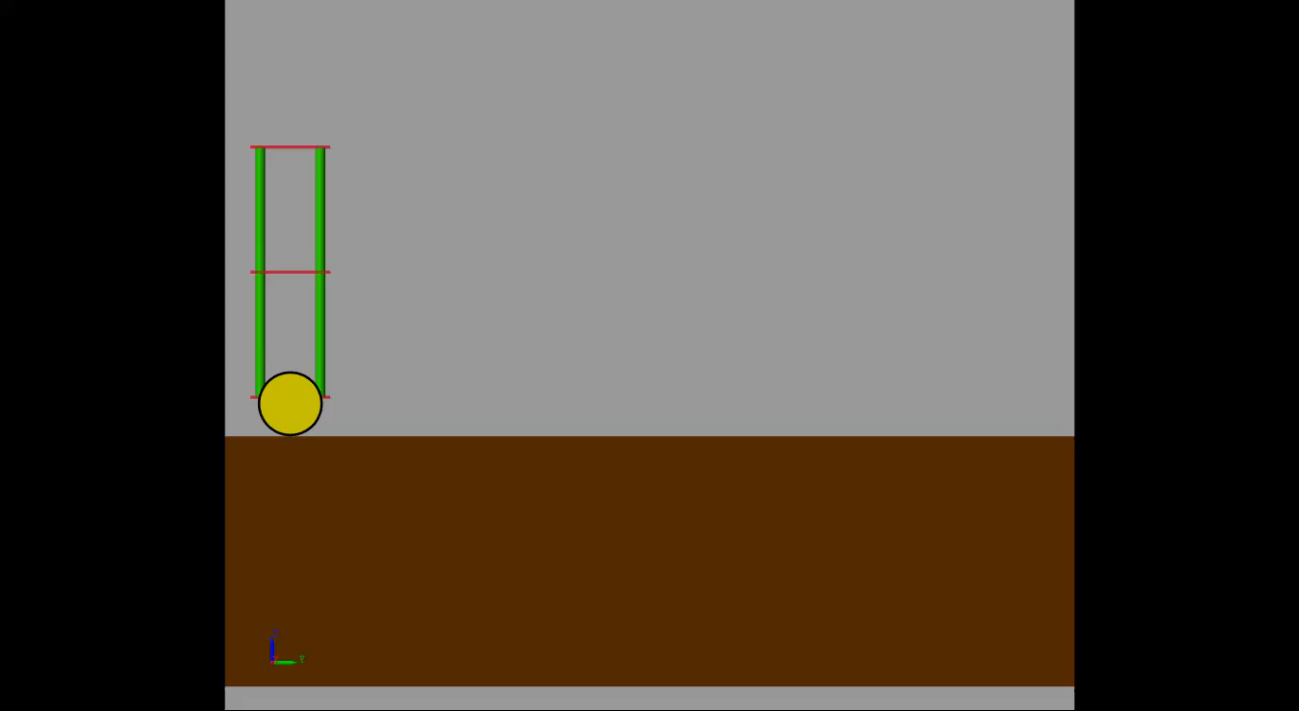
Results
Video: PID Controlled Segway Robot Simulation in MATLAB-SIMULINK

Slide 18
References
Mudeng, V., Hassanah, B., Priyanto, Y. T. K., & Saputra, O. (2020). Design and simulation of two-wheeled balancing mobile robot with PID controller. International Journal of Sustainable Transportation Technology, 3(1), 12-19.
Putra, L. G. B., Wahab, F., & Tamba, T. A. (2025). Design and implementation of linear quadratic regulator control for two-wheeled self-balancing robot. Bulletin of Electrical Engineering and Informatics, 14(2), 931-939.* https://doi.org/10.11591/eei.v14i2.8689
Mohammed, I. K., & Abdulla, A. I. (2020). Balancing a Segway robot using LQR controller based on genetic and bacteria foraging optimization algorithms. TELKOMNIKA Telecommunication, Computing, Electronics and Control, 18(5), 2642-2653.* https://doi.org/10.12928/telkomnika.v18i5.14717
Feriyonika, F., & Hidayat, A. (2020). Balancing control of two-wheeled robot by using linear quadratic Gaussian (LQG). Journal of Telecommunication, Electronic and Computer Engineering, 12(3), 55-61.
Burkan, R., & Ozguney, O. (2017). Balance control of Segway robots using adaptive-robust controller. International Scientific Journal Industry 4.0, 2(1), 38-41.

Slide 19
Thank You

